Slide 1
Introduction to
Cybersecurity
David J. Malan
malan@harvard.edu

Slide 2
Souvenir Photo

Slide 3
Introduction to
Cybersecurity
David J. Malan
malan@harvard.edu

Slide 4
Securing Accounts

Slide 5
🔑

Slide 6
Authentication

Slide 7
Authorization

Slide 8
Usernames

Slide 9
Passwords

Slide 10
Dictionary Attacks

Slide 11
Brute-Force Attacks

Slide 12
4 digits

Slide 13
10 × 10 × 10 × 10

Slide 14
10⁴

Slide 15
10,000

Slide 16
4 letters

Slide 17
26 × 26 × 26 × 26

Slide 18
52 × 52 × 52 × 52

Slide 19
52⁴

Slide 20
7,311,616

Slide 21
4 characters

Slide 22
94 × 94 × 94 × 94

Slide 23
94⁴

Slide 24
78,074,896

Slide 25
8 characters

Slide 26
94⁸

Slide 27
6,095,689,385,410,816

Slide 28
National Institute of
Standards and Technology (NIST)
Notes:
https://pages.nist.gov/800-63-3/sp800-63b.html

Slide 29
"Memorized secrets SHALL be at least 8 characters
in length…"
Notes:
https://pages.nist.gov/800-63-3/sp800-63b.html

Slide 30
"Verifiers SHOULD permit subscriber-chosen memorized secrets at least 64 characters in length. All printing ASCII characters as well as the space character SHOULD be acceptable in memorized secrets. Unicode characters SHOULD be accepted as well."
Notes:
https://pages.nist.gov/800-63-3/sp800-63b.html

Slide 31
"… verifiers SHALL compare the prospective secrets against a list that contains values known to be commonly-used, expected, or compromised…
"Passwords obtained from previous breach corpuses.
"Dictionary words.
"Repetitive or sequential characters (e.g. 'aaaaaa', '1234abcd').
"Context-specific words, such as the name of the service, the username, and derivatives thereof."
Notes:
https://pages.nist.gov/800-63-3/sp800-63b.html

Slide 32
"Memorized secret verifiers SHALL NOT permit the subscriber to store a "hint" that is accessible to an unauthenticated claimant. Verifiers SHALL NOT prompt subscribers to use specific types of information (e.g., "What was the name of your first pet?") when choosing memorized secrets."
Notes:
https://pages.nist.gov/800-63-3/sp800-63b.html

Slide 33
"Verifiers SHOULD NOT require memorized secrets to be changed arbitrarily (e.g., periodically)."
Notes:
https://pages.nist.gov/800-63-3/sp800-63b.html

Slide 34
"Verifiers SHALL implement a rate-limiting mechanism that effectively limits the number of failed authentication attempts that can be made on the subscriber’s account…"
Notes:
https://pages.nist.gov/800-63-3/sp800-63b.html

Slide 35
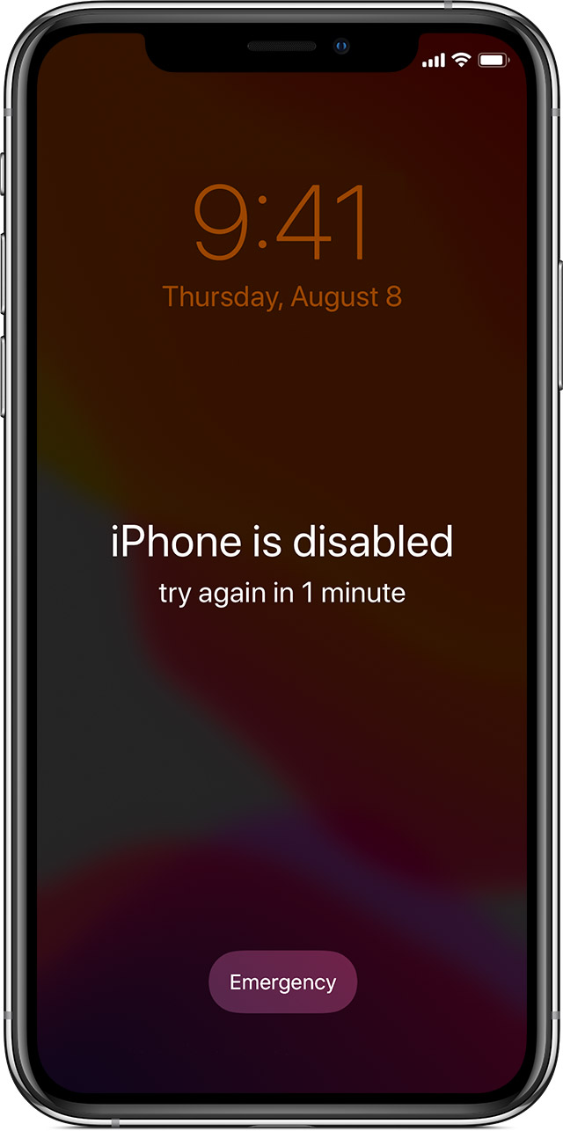
Notes:
https://support.apple.com/en-us/HT204306

Slide 36
Two-Factor Authentication (2FA)

Slide 37
Multi-Factor Authentication

Slide 38
Knowledge
Possession
Inherence
…

Slide 39
Biometrics

Slide 40
One-Time Password (OTP)

Slide 41
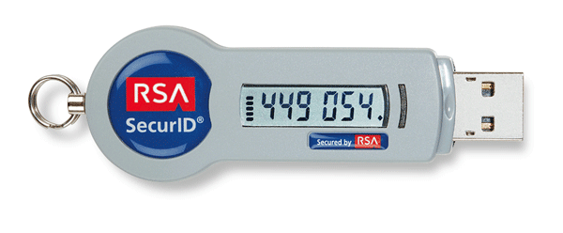
Notes:
https://www.tokenguard.com/RSA-SecurID-SID800.asp

Slide 42
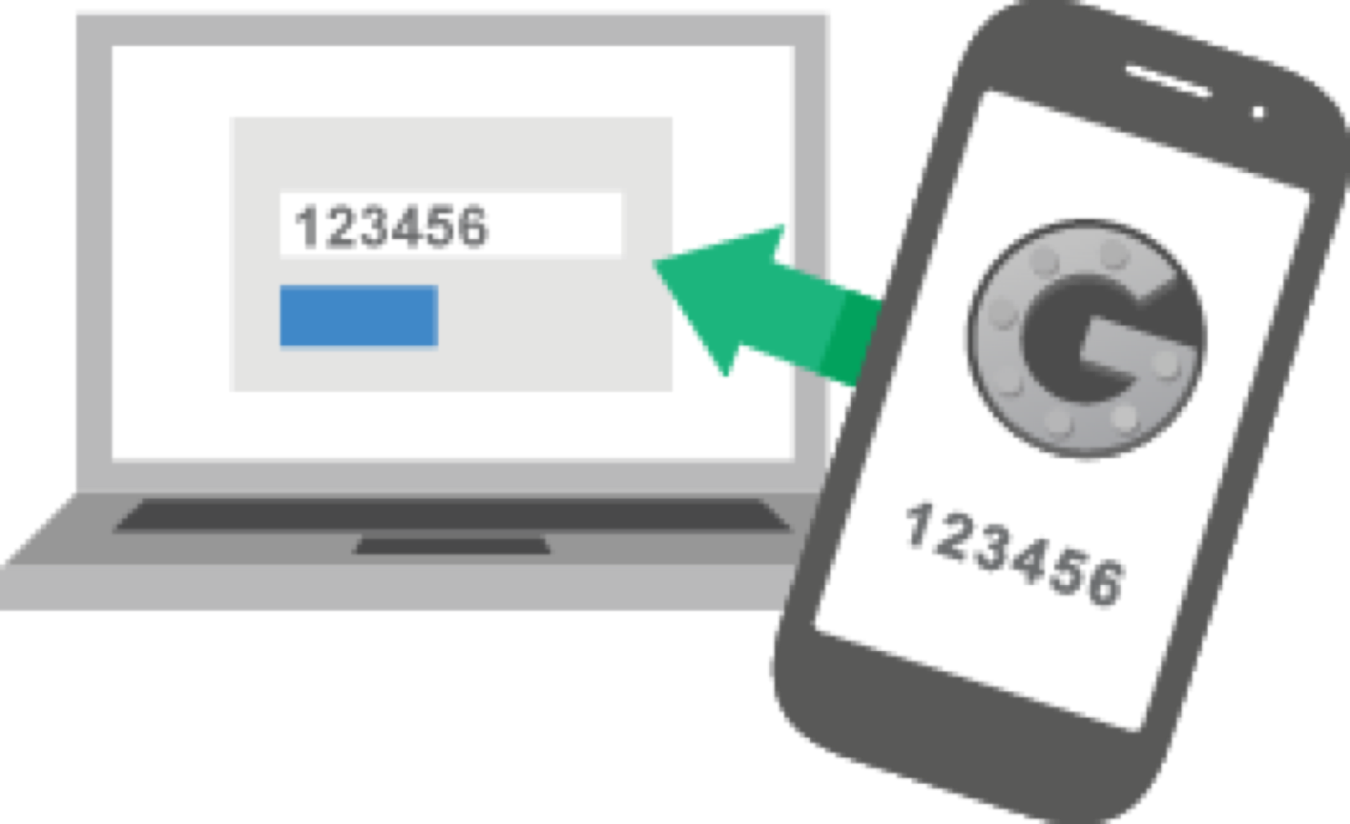
Notes:
https://www.tokenguard.com/RSA-SecurID-SID800.asp

Slide 43
SIM Swapping

Slide 44
Keylogging

Slide 45
Credential Stuffing

Slide 46
Social Engineering

Slide 47
Phishing

Slide 48
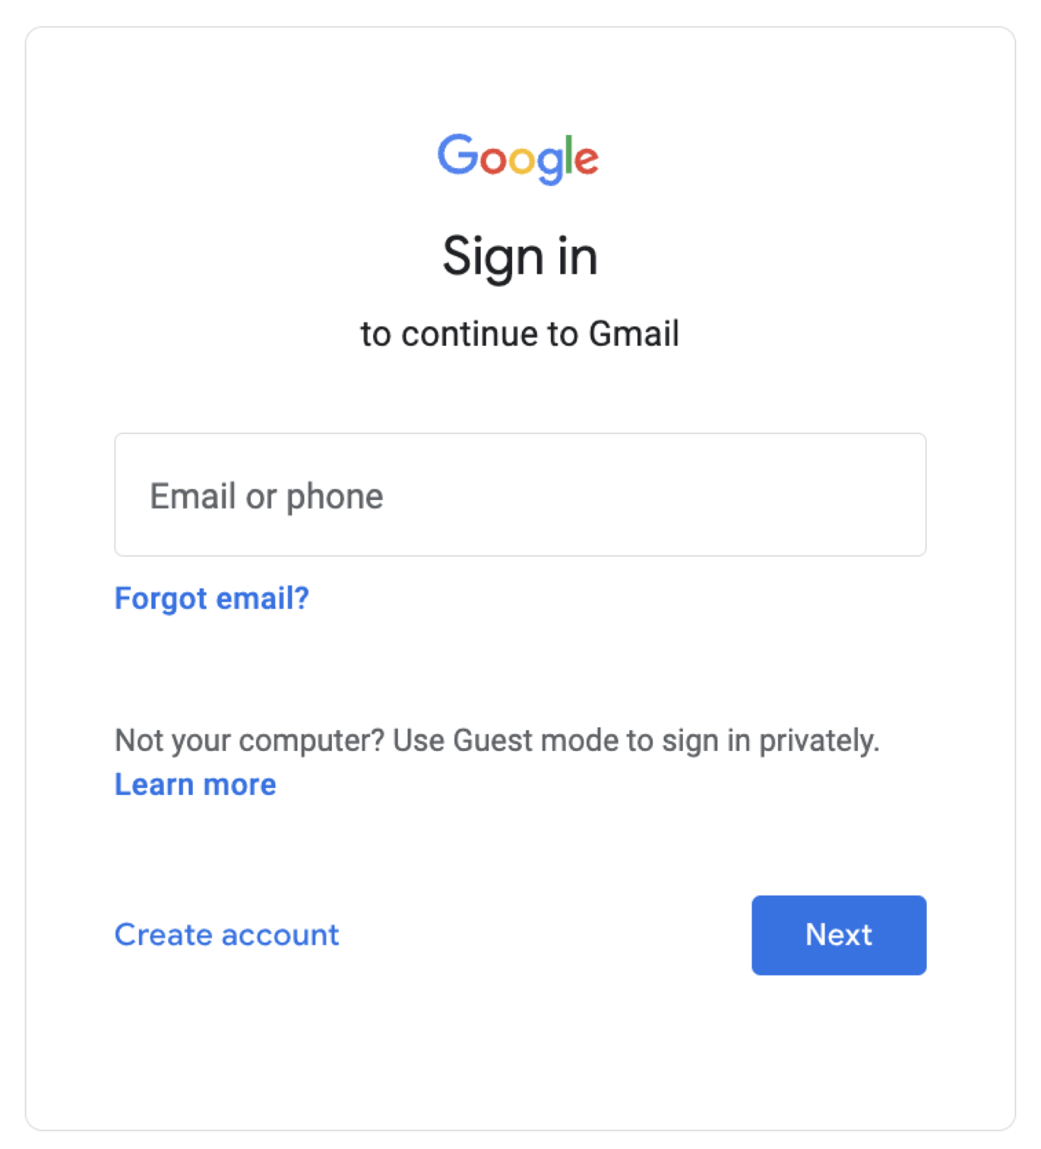

Slide 49
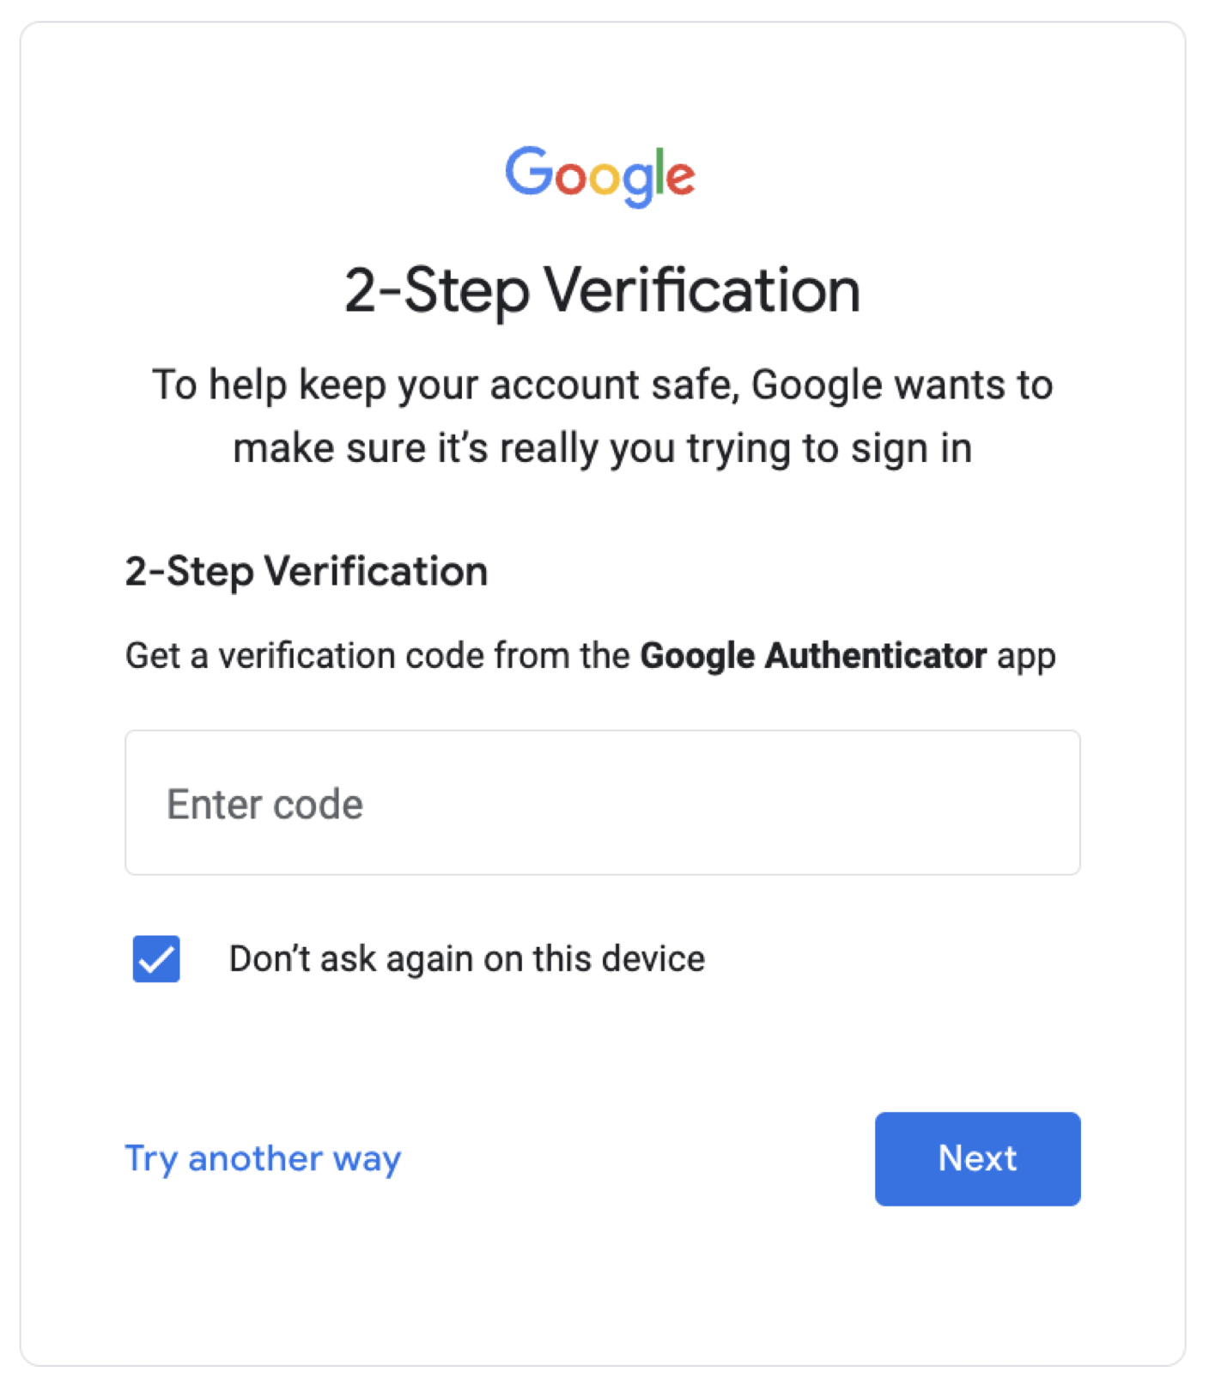

Slide 50
Machine-in-the-Middle Attacks
Notes:
https://csrc.nist.gov/glossary/term/man_in_the_middle_attack

Slide 51
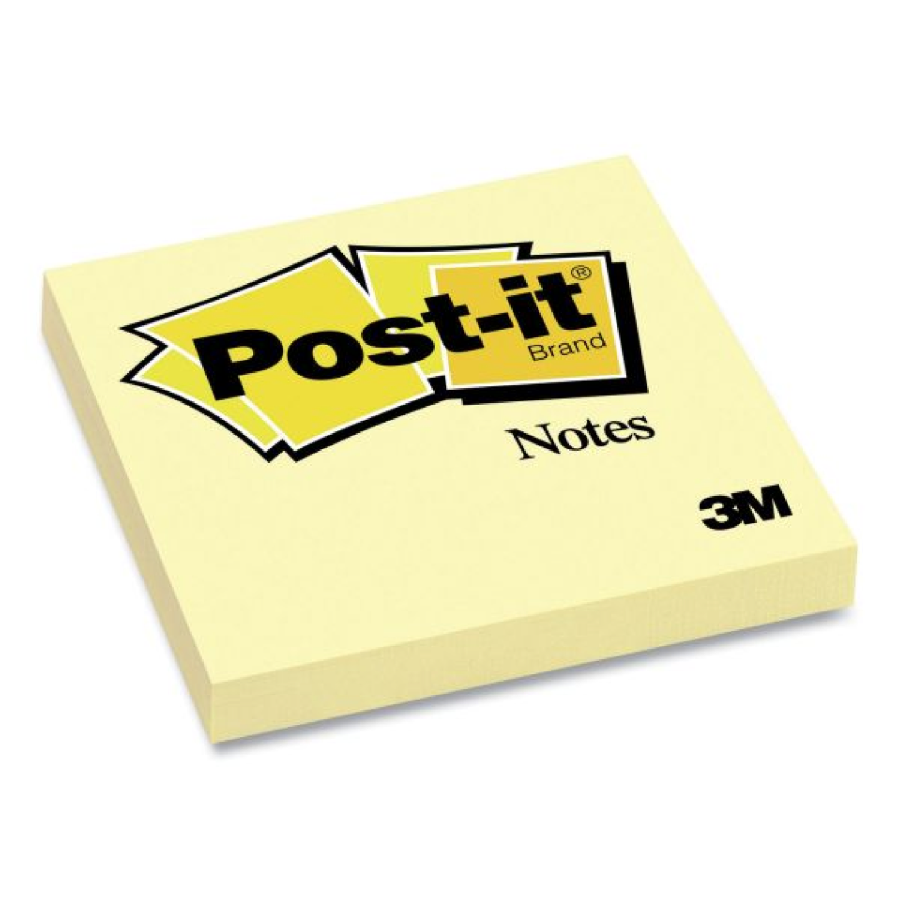
Notes:
https://www.officesupply.com/school-supplies/student-teacher-supplies/teacher-aids/note-pads/post-notes-original-pads-canary-yellow-sheets/p1111234.html

Slide 52
Single Sign-On (SSO)

Slide 53
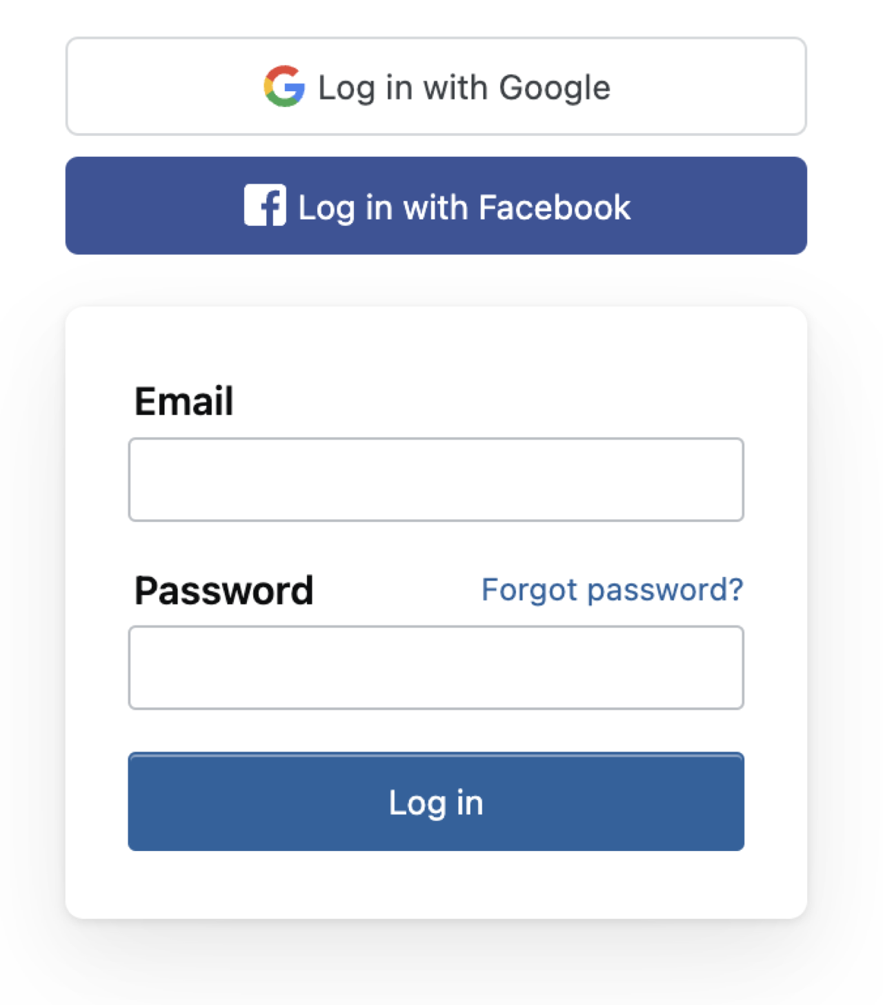

Slide 54
Password Managers

Slide 55
Apple iCloud Keychain
Google Password Manager
Microsoft Credential Manager
...

Slide 56
Passkeys

Slide 57
"Verifiers SHALL store memorized secrets in a form that is resistant to offline attacks. Memorized secrets SHALL be salted and hashed using a suitable one-way key derivation function... Their purpose is to make each password guessing trial by an attacker who has obtained a password hash file expensive and therefore the cost of a guessing attack high or prohibitive. "
Notes:
TODO: put in Data lecture

Slide 58
Introduction to
Cybersecurity
David J. Malan
malan@harvard.edu

